Slide 1
Gradient Location and Orientation Histogram (GLOH)
GOBIKA (2023510012)

Slide 2

WHAT ARE IMAGE DISCRIPTORS?
Image descriptors are numerical representations that capture key visual features of an image or image region. Represent important features in an image (e.g., edges, corners, textures).
They help computers understand and compare images by converting visual information into feature vectors.

Slide 3
Why are Image Descriptors Important in Computer Vision?
Enable image matching, object recognition, classification, and tracking.
Allow efficient comparison of images in terms of texture, shape, edges, and patterns.
Used in facial recognition, medical imaging, satellite analysis, etc.
Popular Image Descriptors
SIFT – Scale-Invariant Feature Transform
SURF – Speeded Up Robust Features
ORB – Oriented FAST and Rotated BRIEF
GLOH – Gradient Location and Orientation Histogram

Slide 4
DEFINITION OF GLOH
It is extension of SIFT
GLOH is a local image descriptor that captures the gradient orientation and spatial location of features around keypoints.
It represents the local structure of an image patch as a high-dimensional vector.
GLOH takes the idea of HOG but adds another crucial element: the spatial location of the gradients. While HOG focuses on what the gradient is (direction and magnitude), GLOH focuses on where the gradient is, i.e., the spatial arrangement of the gradients in the image.
Notes:
GLOH is a method used by computers to understand parts of an image — like corners, edges, and patterns — by turning them into numbers. These numbers help the computer find similar parts in different images.

Slide 5
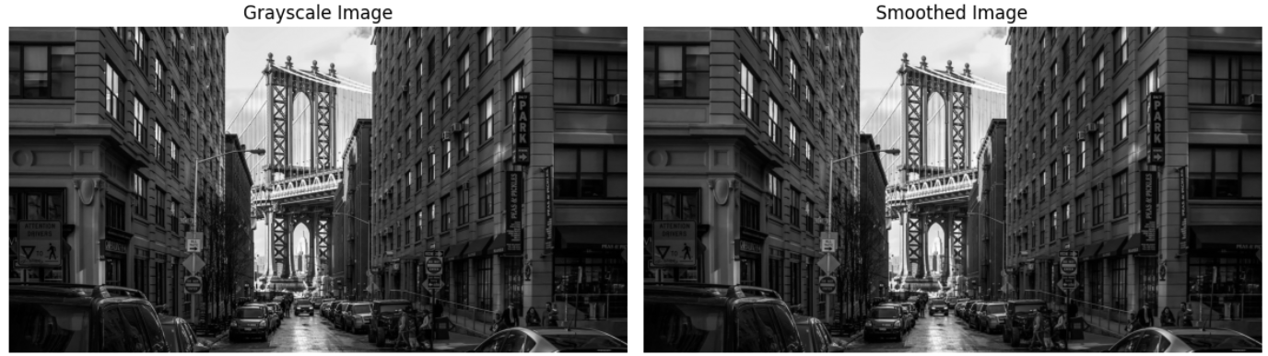
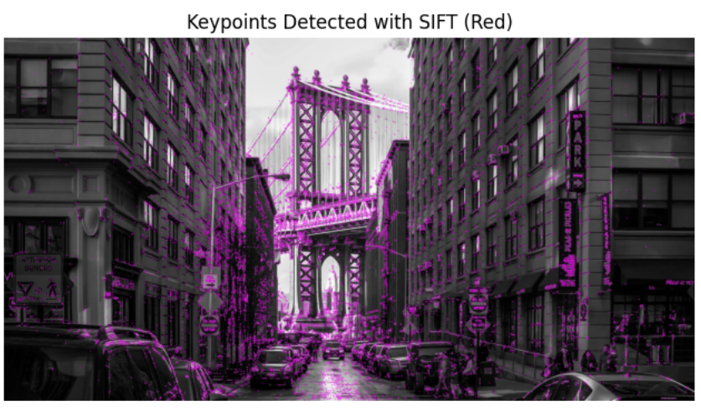
WORKING FLOW OG GLOH
STEP 1:
Preprocessing the Image: Convert the image to grayscale
and apply Gaussian smoothing to reduce noise.
STEP 2:
Keypoint Detection:
Keypoints are detected using SIFT (but you can substitute with other detectors like SURF or Harris).

Slide 6
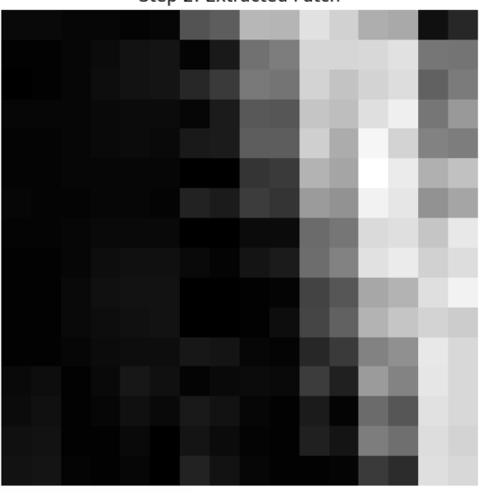
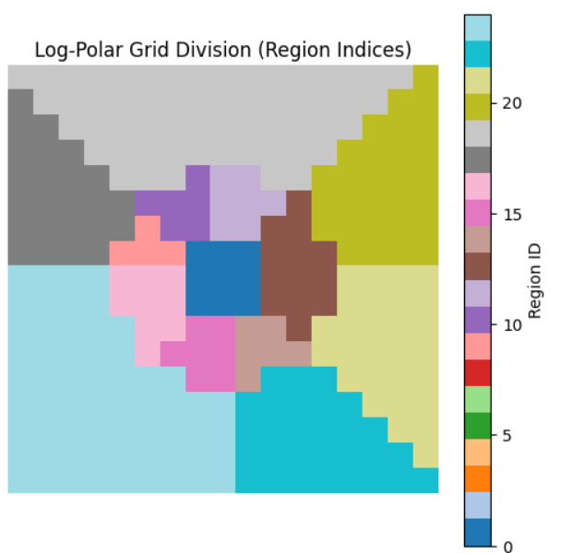
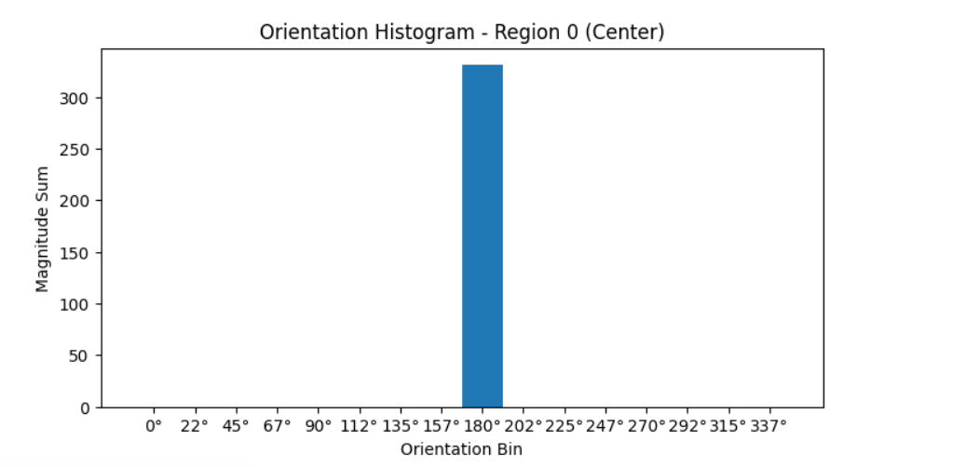
STEP 3:
Patch Extraction Around each keypoint, extract a fixed-size image patch(I shown for single keypoint) (e.g., 17×17 pixels).
STEP 4:
Log-Polar Grid Division Divide the patch into a log-polar grid:
Typically 3 radial bins × 8 angular bins
Plus 1 central region → Total of 17 regions
STEP 5:Gradient Computation For each pixel in the patch:
Compute gradient magnitude and orientation (angle).
I’m just computed for one patch.

Slide 7
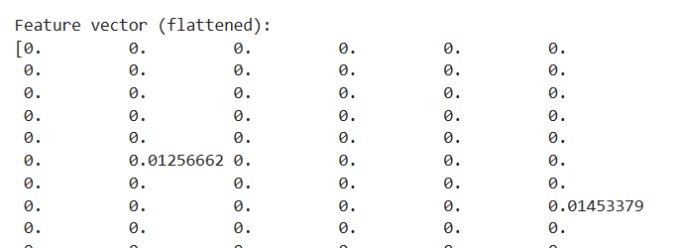
STEP :6
Flatten the Histograms:
For 3 radial bins × 8 angular bins → 24 regions, each with 16 bins, the correct feature vector length should indeed be 384 components.
OUTPUT:
Feature Vector:
The final output is the normalized feature vector representing the patch. This vector can be used for tasks like matching keypoints across images or object recognition.

Slide 8
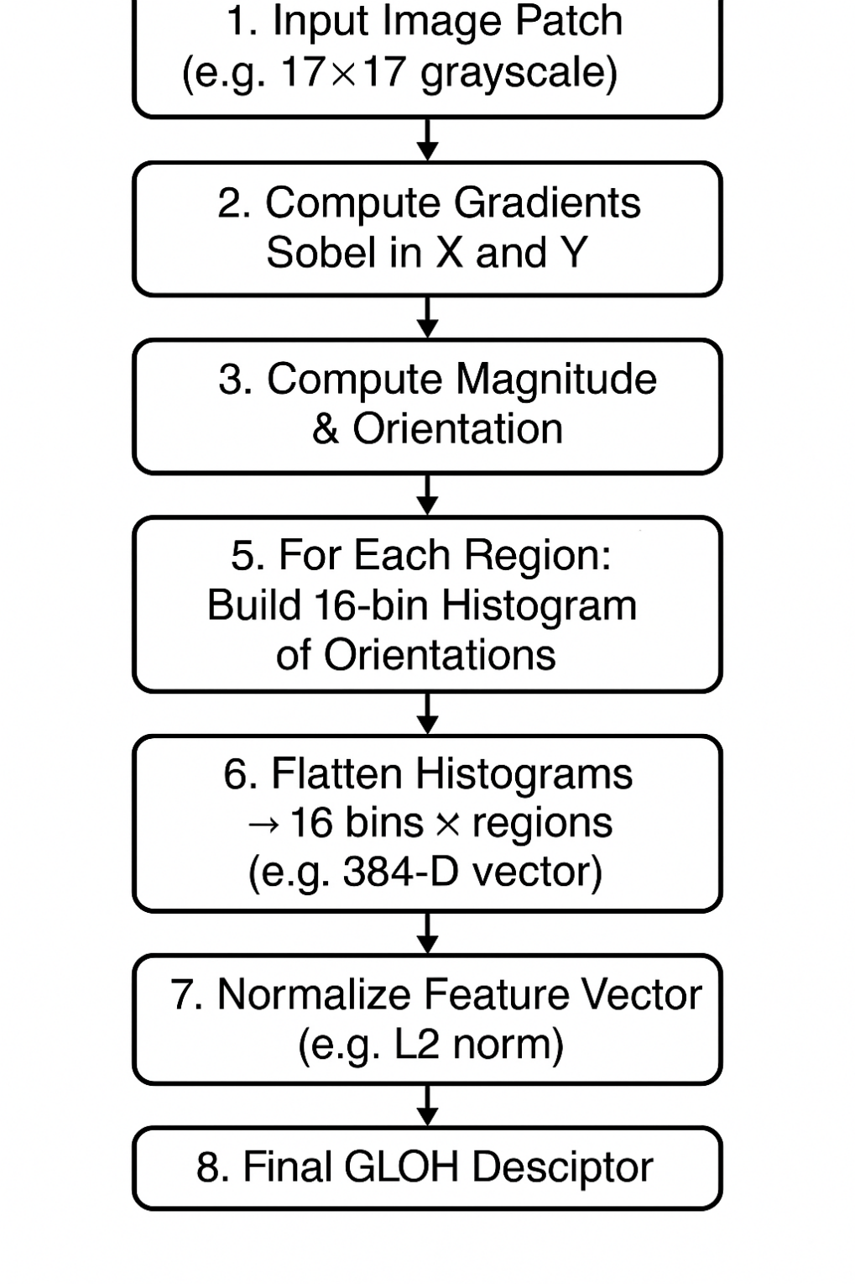

Slide 9
Advantages
High Accuracy – More distinctive than SIFT for matching keypoints.
Rotation Invariance – Log-polar grid gives better handling of rotation.
Powerful Feature Representation – Captures both gradient and spatial information in detail.
Disadvantages
Computationally Heavy – Slower and more complex to compute than HOG or SIFT.
Large Descriptor Size – 384 dimensions (needs PCA for compression).
Needs Keypoint Detection – Can't be used directly on full images.

Slide 10
5 key differences between HOG and GLOH:
Aspect | HOG (Histogram of Oriented Gradients) | GLOH (Gradient Location and Orientation Histogram)
1. Grid Structure | Rectangular grid (cells & blocks) | Log-polar grid (radial & angular bins)
2. Purpose | Object detection (e.g., pedestrians) | Keypoint-based image matching
3. Keypoint Dependency | Applied densely over the image | Computed only at keypoints (like SIFT)
4. Dimensionality | Lower (e.g., 36–144) | High (384), often reduced to 128 via PCA
5. Rotation Invariance | Limited rotational invariance | Better rotational invariance due to polar binning

Slide 11
APPLICATIONS:
✅ Keypoint Matching
Used to match points between images for tasks like object recognition and tracking.
More robust than traditional descriptors due to high detail.
✅ Image Stitching / Panorama Creation
Aligns and merges overlapping images accurately by matching local keypoints.
✅ 3D Reconstruction
Tracks corresponding keypoints across multiple images to build 3D structures.

Slide 12
THANK YOU!!

